Slide 1
HEDIS(Healthcare Effectiveness Data & Information Services) 2016
23th Feb 2017

Slide 2
Agenda
Introduction
Measures
Measure Lifecycle
Differences in HEDIS 2015 and 2016
Data Collection Methods
Health Insurance Plan Ratings
Advantages & Challenges
References

Slide 3
HEDIS
The Healthcare Effectiveness Data and Information Set (HEDIS) is one of the most widely used sets of health care performance measure in the United States.
HEDIS was originally developed by employers and the HMO group in 1991; NCQA took charge of HEDIS in 1992
NCQA began developing HEDIS in the early 1990s and has been collecting HEDIS on a nationwide basis for commercial, Medicaid and Medicare managed care plans since 1997
Health plans also use HEDIS results themselves to see where they need to focus their improvement efforts

Slide 4
HEDIS Measures
HEDIS consists of 90 measures across 7 domains of care
Measures | HEDIS 2016
Effectiveness of Care | 53
Access/Availability of Care | 7
Experience of Care | 3
Utilization and Risk Adjusted Utilization | 14
Relative Resource Use | 5
Health Plan Descriptive Information | 7
Measures Collected Using Electronic Clinical Data Systems | 1

Slide 5
HEDIS Measures : Domains
Effectiveness of Care
Effectiveness of Care measures generally look at the impact of care delivered to certain populations enrolled in a health plan.
In most cases, the measured impact is positive and higher the score on a measure, the better
e.g. Breast Cancer Screening
Access/ Availability of Care
This domain includes measures that assess how many members use basic plan services
e.g. Call Answer Timeline
Experience of Care
Member satisfaction survey results can be another effective tool in evaluating health plan performance—a tool that can be used by purchasers making health plan selections for their employees
e.g. CAHPS Health Plan Survey

Slide 6
HEDIS Measures : Domains
Utilization And Risk Adjusted Utilization
The aim of applying a risk adjustment strategy to these utilization measures is to allow better comparison of inpatient and ED use across health plans and to create an “even playing field” by removing the effect of select patient characteristics and health status differences on the reported results.
e.g. Hospitalization for potentially Preventable Complication.
Relative Resource Use
Relative Resource Use (RRU) measures indicate how intensively plans use physician visits, hospital stays and other resources to care for members identified as having one of five chronic diseases; cardiovascular disease, COPD, diabetes, hypertension and asthma. When evaluated alongside quality measures, RRU measures make it possible to consider quality and spending simultaneously

Slide 7
HEDIS Measures : Domains
Health Plan Descriptive Information
This domain provides consumers and purchasers with information about health plan’s structure, staffing and enrollment characteristics, and how these factors contribute to the plan’s ability to provide its members with effective health care
e.g. Enrollment by product line
Measures Collected Using Electronic Clinical Data Systems
The ECDS(Electronic Clinical Data Systems) provides automated access to information and can create data files for quality reporting.

Slide 8
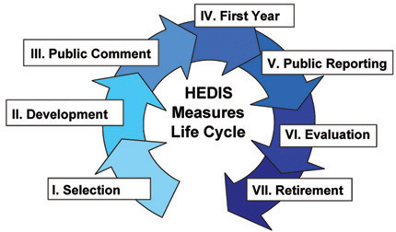
Measure Lifecycle

Slide 9
Difference in HEDIS 2015 and 2016 (2/2)
There are now 7 domains of care rather than 5
Utilization and Relative Resource Use (now split into 2 domains)
- Relative Resource Use Utilization
- Risk Adjusted Utilization
Measures Collected Using Electronic Clinical Data Systems (new)
HEDIS 2016 adds the following 6 new measures:
Effectiveness of Care
- Statin Therapy for Patients With Cardiovascular Disease
- Statin Therapy for Patients With Diabetes
Utilization And Risk Adjusted Utilization
- Inpatient Hospital Utilization
- Emergency Department Utilization
- Hospitalization for Potentially Preventable Complications
Measures Collected Using Electronic Clinical Data Systems
- Utilization of the PHQ-9 to Monitor Depression Symptoms for Adolescents and Adults (DMS)

Slide 10
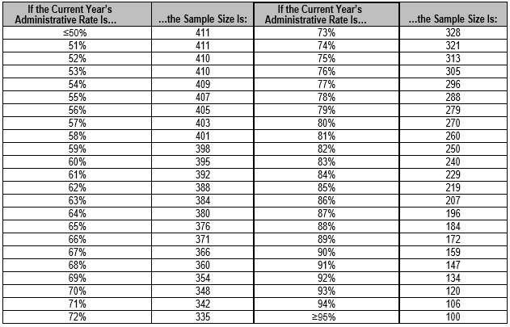
Data Collection Methods
HEDIS Data Collection Methods
Administrative Method:
This method requires health plans to identify the eligible population (i.e., the denominator) using administrative data, derived from claims and encounters (i.e., statistical claims).
Hybrid Method:
This method requires health plans to identify the eligible population using administrative data and then extract a systematic sample of members from the eligible population, which becomes the denominator.
Sample Size for Hybrid Data

Slide 11
Data Collection Methods
e.g. A plan that has 10,000 members who qualify
Using the administrative method, if the plan finds that 4,000 members out of the 10,000 had evidence of a postpartum visit using only administrative data, the final rate for this measure would be 40 percent
After randomly selecting 411 eligible members, the plan finds that 161 members have evidence
The plan then obtains and reviews medical records for the 250 members who do not have evidence
Of those 250 members, the plan finds 54 additional members who have a postpartum visit recorded in the medical record
The final rate for this measure, using the hybrid method, would be (161 + 54)/411, or 52 percent

Slide 12
Data Collection Methods
Survey Method:
NCQA uses the CAHPS survey to assess member experience with care as part of the Satisfaction With Experience of Care domain of HEDIS, a set of health plan performance measures used for both public reporting and accreditation.
The surveys include a core set of questions, with some questions grouped to form composites, or summary results, of key areas of care and service.
The CAHPS version 5.0H surveys are designed to capture accurate and reliable information from consumers about their experiences with their health plan.
To become an NCQA-certified CAHPS 5.0H survey vendor, an organization must demonstrate that it has the capabilities, experience and expert personnel to accurately collect and report survey results.

Slide 13
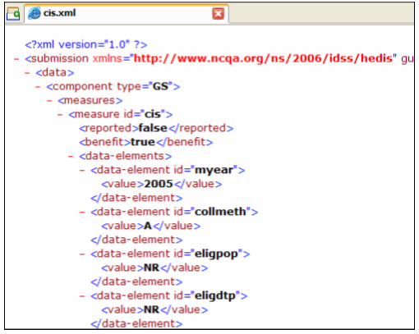
HEDIS Data Submission
NCQA collects HEDIS survey results directly from health plans and through the Healthcare Organization Questionnaire (HOQ)
HEDIS non survey data is collected through the Interactive Data Submission System (IDSS)
Sample xml file

Slide 14
Plans and Ratings
NCQA changed its rankings methodology in 2015. The new methodology will be an overall “rating” in half-point increments on a scale of 1–5, where 5 is the highest score and 1 is the lowest score
Which Plans are Rated?
Plans with complete data are rated
Plans with partial or no data are listed but not rated
Plans with Partial Data
Plans with partial data do not receive a rating, but NCQA lists them in the ratings and shows their scores on the measures they report . A plan is considered to be Partial if :
It submits HEDIS and CAHPS measure data for public reporting, but has “missing values” (i.e., NA or NB) in more than 50 percent of the weight of the measures used in the methodology
It submits clinical data for public reporting but did not submit CAHPS data, or vice versa
It achieved NCQA Accreditation without HEDIS data and does not submit clinical or CAHPS data for public reporting
No Data Reported
Plans that submit results but do not publicly report their data
Plans that report no HEDIS or accreditation information to NCQA, are given a Rating status of “No data reported”

Slide 15
Performance calculation
The overall rating is the weighted average of a plan’s HEDIS and CAHPS measure ratings, plus accreditation standards, rounded to the nearest half point.
Weights align with the ratings are :
“1” = Process measures (e.g., screenings, visits).
“1.5” = Patient Experience measures.
“3” = Outcome measures (e.g., HbA1c Control, BP Control).
Health plans who are accredited through the NCQA will receive points for their accreditation status. Accredited plans may increase their overall rating by up to a half-point.
(Actual/possible pts) x 5 x 10% of the weight of valid reported measures
Interim accredited plans may increase their overall rating by one-third the amount that accredited plans
(Actual/possible pts) x 5 x (1/3) x 10% of the weight of valid reported measures

Slide 16
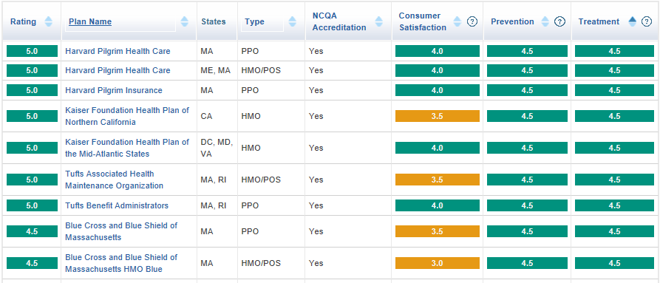
Plans : Ranked
Below is the sample Health Plan Rating for 2015-2016

Slide 17
Advantages
HEDIS Measures focus largely on processes of care and are directly actionable for quality improvement activities
Ensures health plans are offering quality preventive care and service to members.
Employers, consultants, and consumers use HEDIS data, along with accreditation information, to help them select the best health plan for their needs
HEDIS results are included in Quality Compass, an interactive, web-based comparison tool that allows users to view plan results and benchmark information

Slide 18
Challenges
For most organizations, HEDIS filing is an expensive, stressful, and often cumbersome process.
Compliance rates are published nationally and performance numbers significantly impact a health plan’s reputation, network relationships and profit margin

Slide 19
Measures : Effectiveness of Care Domain (1/3)
Measures
Adherence to Antipsychotic Medications for Individuals With Schizophrenia
Adult BMI Assessment
Annual Monitoring for Patients on Persistent Medications
Antidepressant Medication Management
Appropriate Testing for Children With Pharyngitis
Appropriate Treatment for Children With Upper Respiratory Infection
Aspirin Use and Discussion
Asthma Medication Ratio
Avoidance of Antibiotic Treatment in Adults With Acute Bronchitis
Breast Cancer Screening
Cardiovascular Monitoring for People With Cardiovascular Disease and Schizophrenia
Care for Older Adults
Cervical Cancer Screening
Cervical Cancer Screening
Chlamydia Screening in Women
Use of Spirometry Testing in the Assessment and Diagnosis of COPD
Weight Assessment and Counseling for Nutrition and Physical Activity for Children/Adolescents

Slide 20
Measures : Effectiveness of Care Domain (2/3)
Measures
Colorectal Cancer Screening
Comprehensive Diabetes Care
Controlling High Blood Pressure
Diabetes Monitoring for People With Diabetes and Schizophrenia
Diabetes Screening for People With Schizophrenia or Bipolar Disorder Who Are Using Antipsychotic Medications
Disease-Modifying Anti Rheumatic Drug Therapy for Rheumatoid Arthritis
Fall Risk Management
Flu Vaccinations for Adults Ages 18-64
Flu Vaccinations for Adults Ages 65 and Older
Follow-Up After Hospitalization for Mental Illness
Follow-Up Care for Children Prescribed ADHD Medication
Human Papillomavirus Vaccine for Female Adolescents
Immunizations for Adolescents
Lead Screening in Children
Management of Urinary Incontinence in Older Adults
Medical Assistance With Smoking and Tobacco Use Cessation

Slide 21
Measures : Effectiveness of Care Domain (3/3)
Measures
Medicare Health Outcomes Survey
Medication Management for People With Asthma
Medication Reconciliation PostDischarge
Metabolic Monitoring for Children and Adolescents on Antipsychotics
Non-Recommended Cervical Cancer Screening in Adolescent Females
Non-Recommended PSA-Based Screening in Older Men
Osteoporosis Management in Women Who Had a Fracture
Osteoporosis Testing in Older Women
Persistence of Beta-Blocker Treatment After a Heart Attack
Pharmacotherapy Management of COPD Exacerbation
Physical Activity in Older Adults
Pneumococcal Vaccination Status for Older Adults
Potentially Harmful Drug-Disease Interactions in the Elderly
Statin Therapy for Patients With Cardiovascular Disease
Statin Therapy for Patients With Diabetes
Use of High-Risk Medications in the Elderly
Use of Imaging Studies for Low Back Pain
Use of Multiple Concurrent Antipsychotics in Children and Adolescents

Slide 22
Measures : Access/Availability & Experience of Care domain
Domains | Measures
Access/Availability of Care | Adults’ Access to Preventive/ Ambulatory Health Services
 | Children’s and Adolescents’ Access to Primary Care Practitioners
 | Annual Dental Visit
 | Initiation and Engagement of Alcohol and Other Drug Dependence Treatment
 | Prenatal and Postpartum Care
 | Call Answer Timeliness
 | Use of First-Line Psychosocial Care for Children and Adolescents on Antipsychotics
Experience of Care | CAHPS Health Plan Survey 5.0H, Adult Version
 | CAHPS Health Plan Survey 5.0H, Child Version
 | Children With Chronic Conditions

Slide 23
Measures : Utilization And Risk Adjusted Utilization
Measures
Frequency of Ongoing Prenatal Care
Well-Child Visits in the First 15 Months of Life
Well-Child Visits in the Third, Fourth, Fifth and Sixth Years of Life
Adolescent Well-Care Visits
Frequency of Selected Procedures
Ambulatory Care
Inpatient Utilization—General Hospital/ Acute Care
Identification of Alcohol and Other Drug Services
Mental Health Utilization
Antibiotic Utilization
Plan All-Cause Readmissions
Inpatient Hospital Utilization
Emergency Department Utilization
Hospitalization for Potentially Preventable Complications

Slide 24
Measures : Relative Resource Use
\Health Plan Descriptive Information \ ECDS
Domains | Measures
Relative Resource Use | Relative Resource Use for People With Diabetes
 | Relative Resource Use for People With Cardiovascular Conditions
 | Relative Resource Use for People With Hypertension
 | Relative Resource Use for People With COPD
 | Relative Resource Use for People With Asthma
Health Plan Descriptive Information | Board Certification
 | Enrollment by Product Line
 | Enrollment by State
 | Language Diversity of Membership
 | Race/Ethnicity Diversity of Membership
 | Weeks of Pregnancy at Time of Enrollment
 | Total Membership
Measures Collected Using Electronic Clinical Data Systems | Utilization of the PHQ-9 to Monitor Depression Symptoms for Adolescents and Adults

Slide 25
References
http://www.ncqa.org/
http://www.ncqa.org/tabid/425/Default.aspx
http://en.wikipedia.org/wiki/Healthcare_Effectiveness_Data_and_Information_Set
http://www.ncqa.org/HEDISQualityMeasurement/HEDISMeasures/HEDIS2015.aspx
http://www.ncqa.org/HEDISQualityMeasurement/HEDISMeasures/HEDIS2016.aspx
https://cahps.ahrq.gov/surveys-guidance/hp/about/NCQAs-CAHPS-HP-Survey.html
http://healthplanrankings.ncqa.org/

Slide 26
THANK YOU

